Slide 1
Python mySQLclient install and access to database

Slide 2
Install MySQL
Download MySQL at http://www.mysql.com/
see installation guide
https://www.itread01.com/articles/1476681060.html
先安裝Visual Studio ( https://visualstudio.microsoft.com/visual-cpp-build-tools/)
Install MySQL workbench (the same the MySQL server)
https://dev.mysql.com/downloads/workbench/

Slide 3
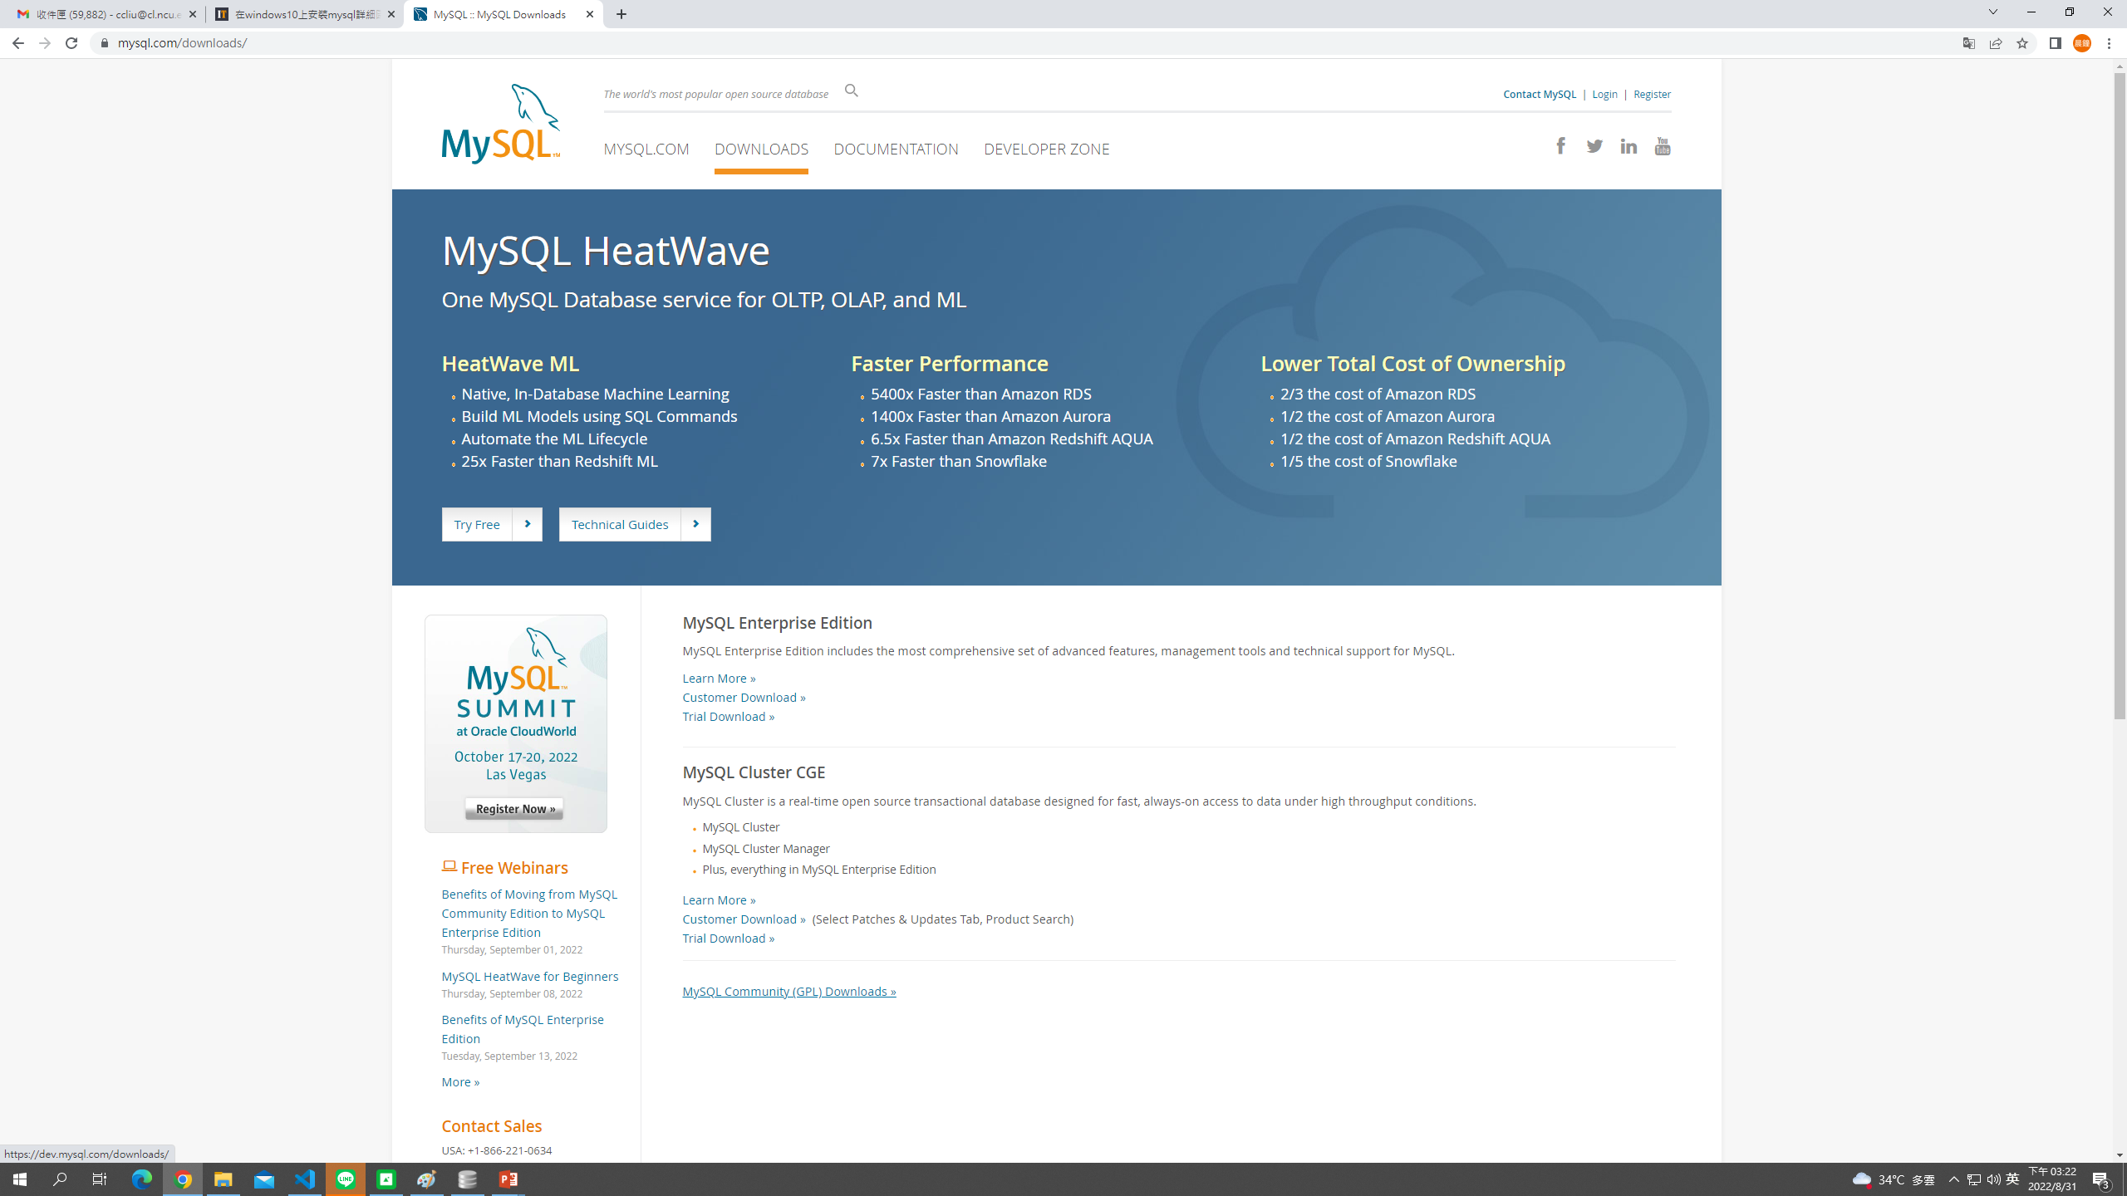

Slide 4
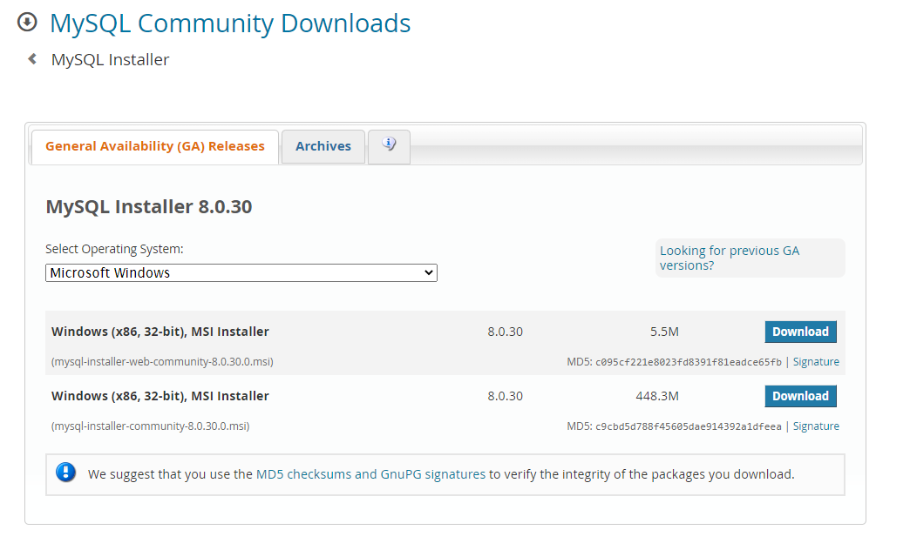

Slide 5
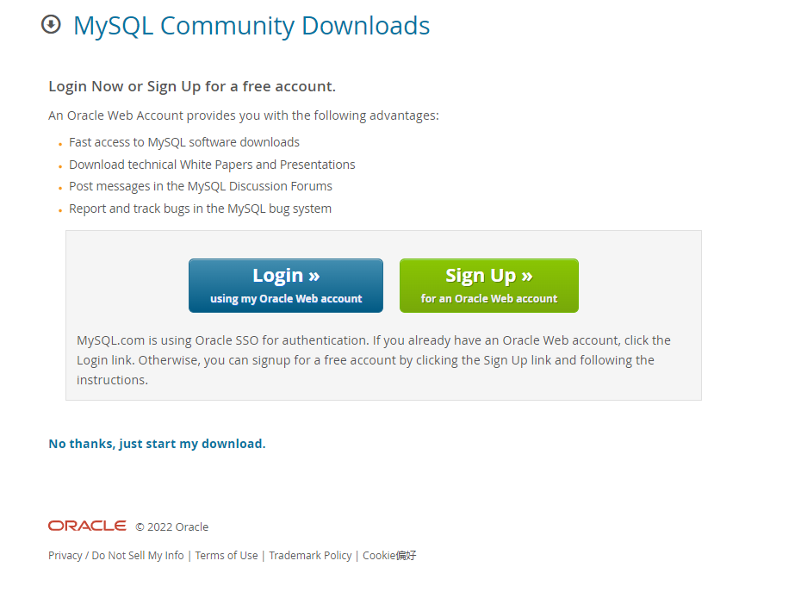

Slide 6
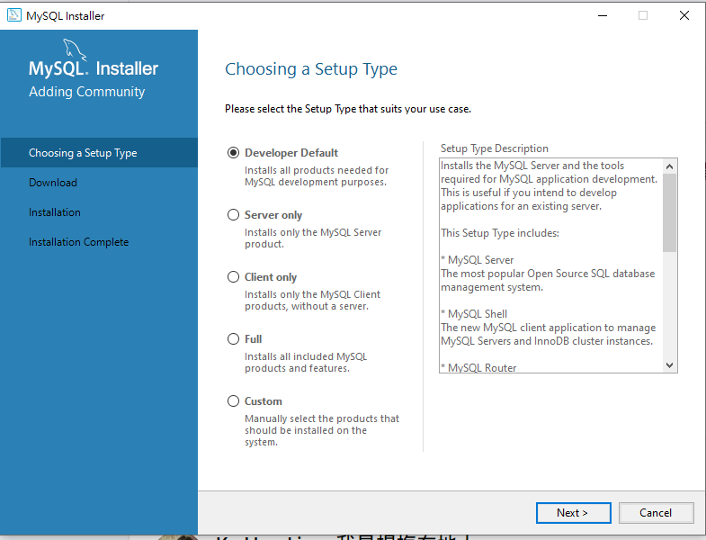

Slide 7
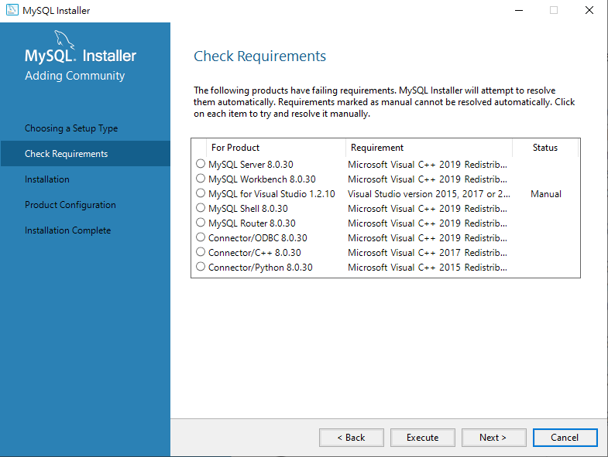

Slide 8
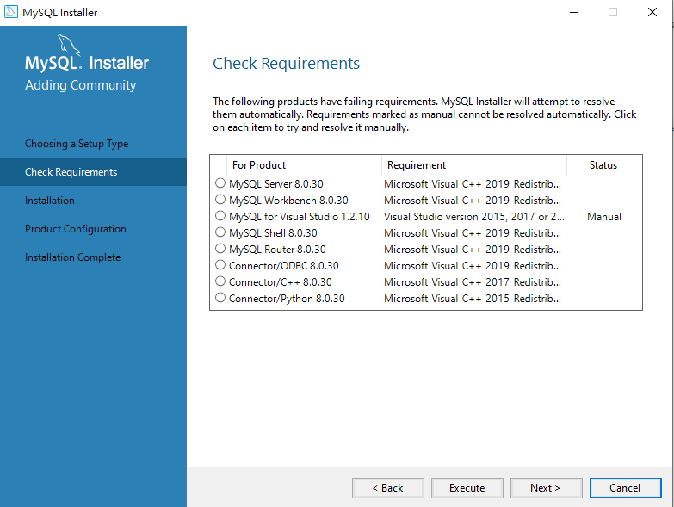
缺元件，按下MySQL Server選項，看看失敗原因
之後按下Execute (不是Next) 來安裝這些元件

Slide 9
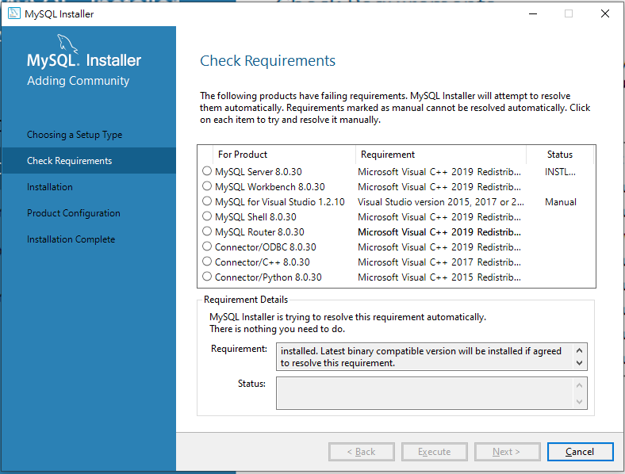

Slide 10
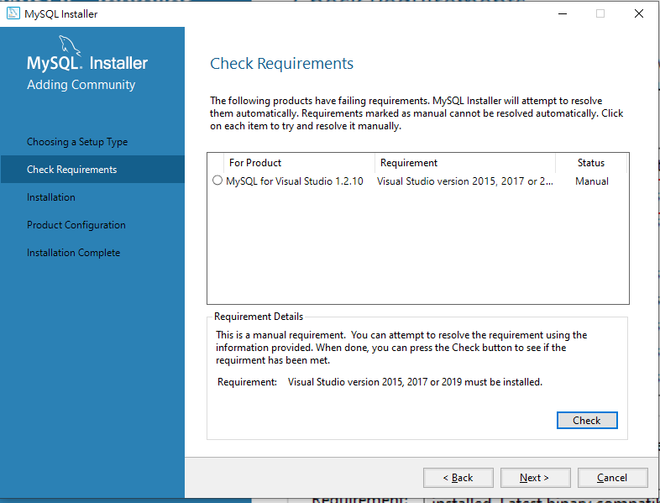
缺Visual studio，要先安裝 visual studio
See https://dba.stackexchange.com/questions/278659/mysql-visual-studio-must-be-installed-but-it-is

Slide 11
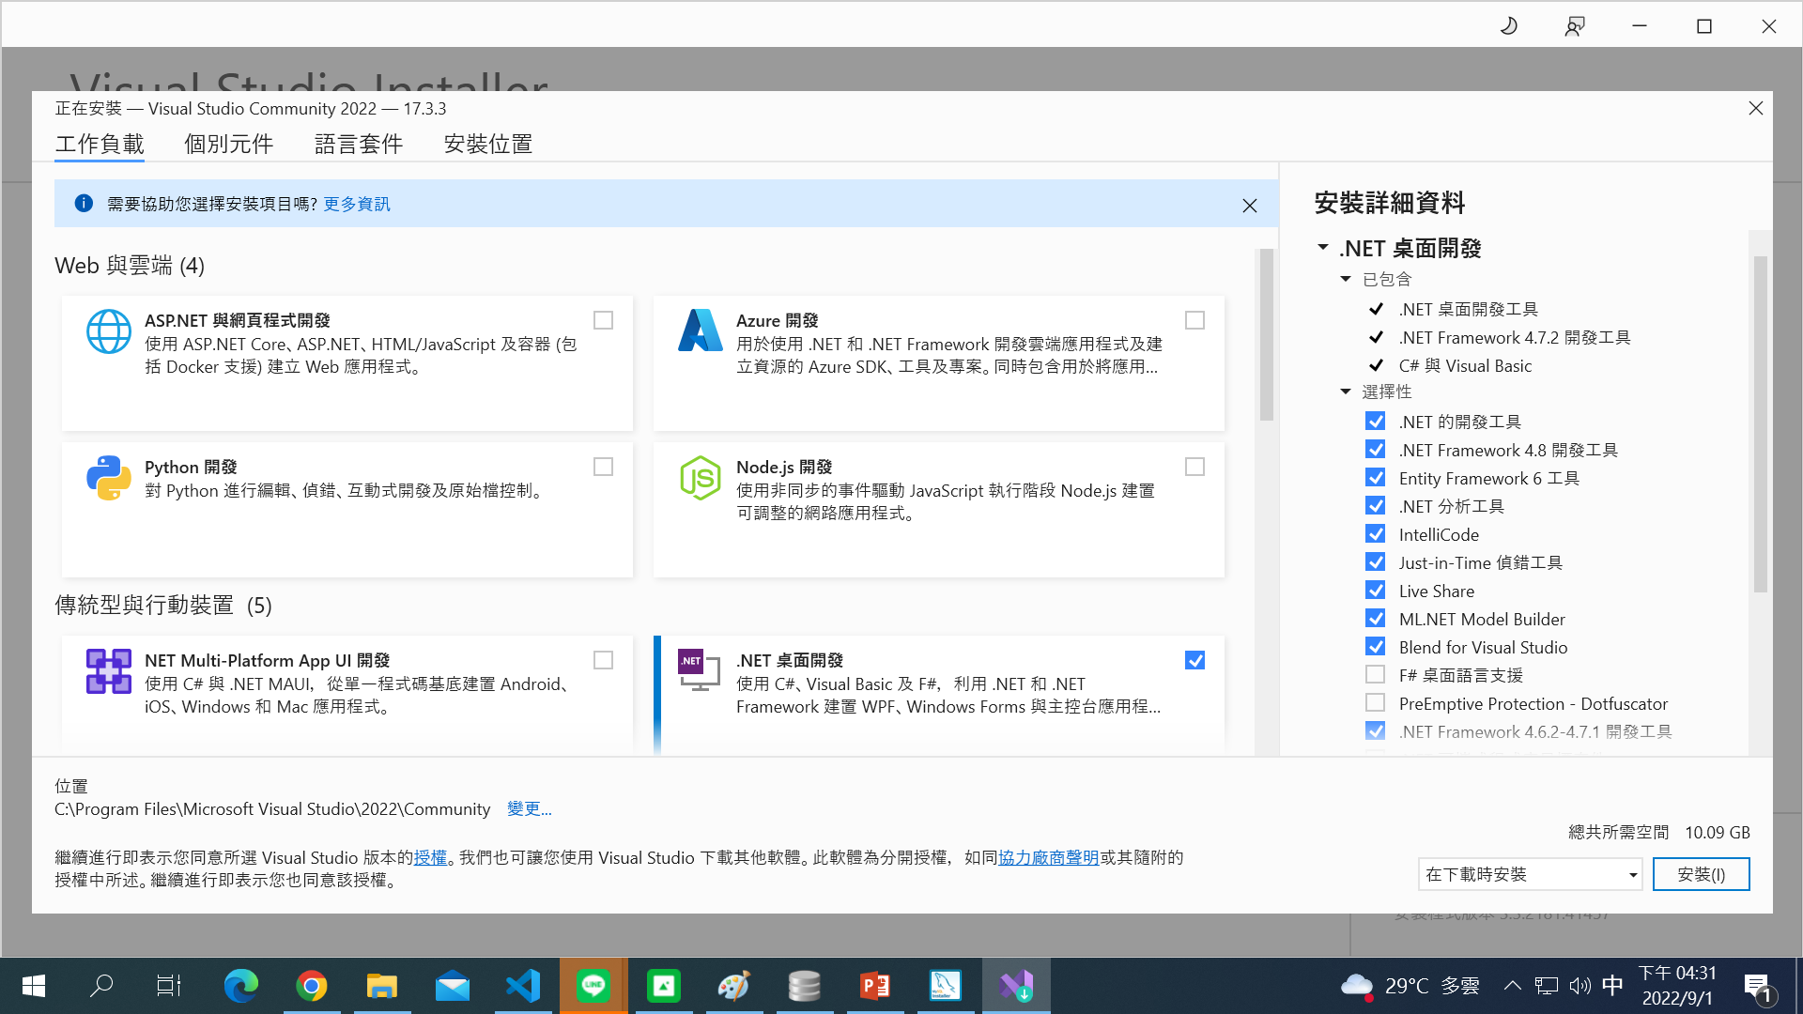
https://visualstudio.microsoft.com/zh-hant/thank-you-downloading-visual-studio/?sku=Community&channel=Release&version=VS2022&source=VSLandingPage&passive=false&cid=2030

Slide 12
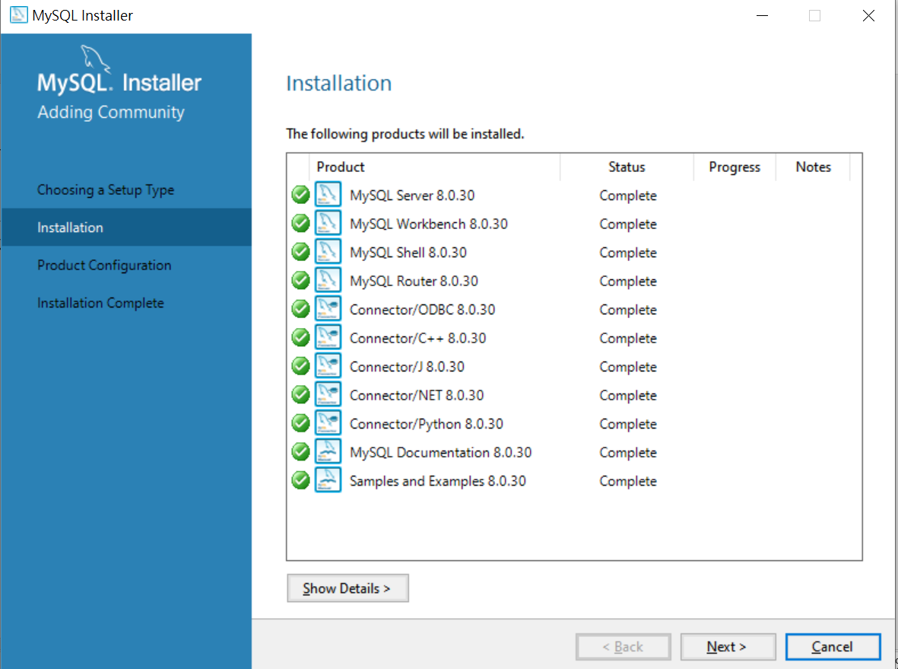
安裝完Visual studio 後，按Back重新檢查後即可安裝。

Slide 13
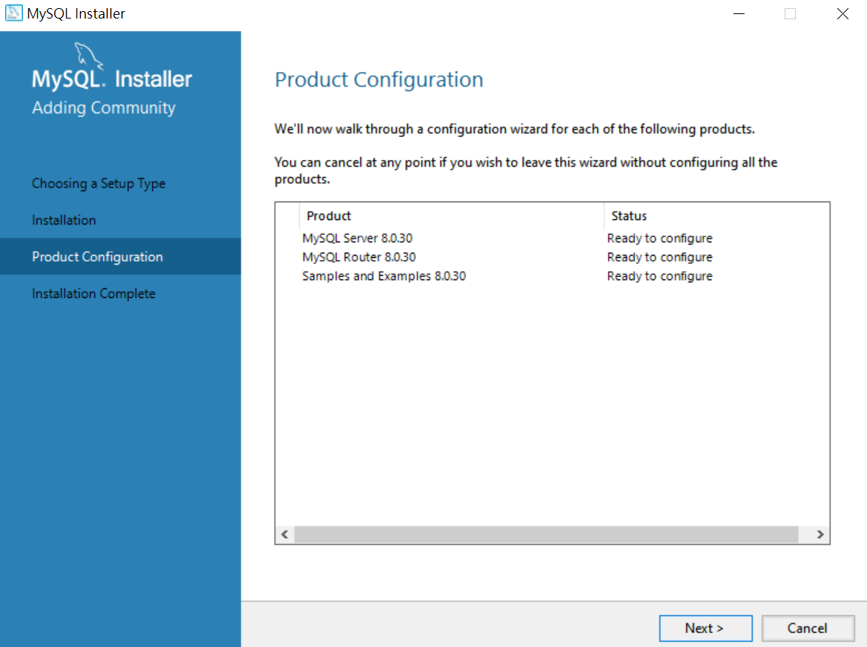

Slide 14
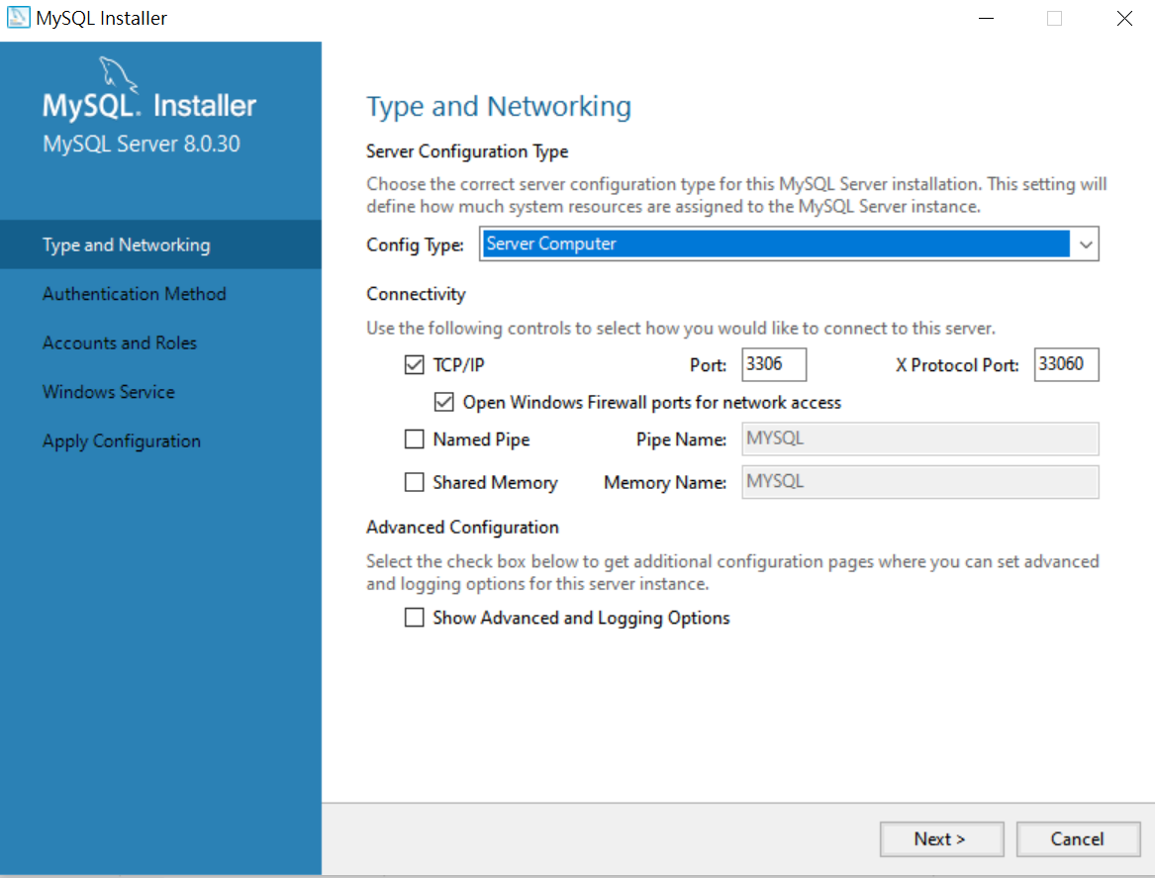
安裝成sever，並記得連線port number 為3306

Slide 15
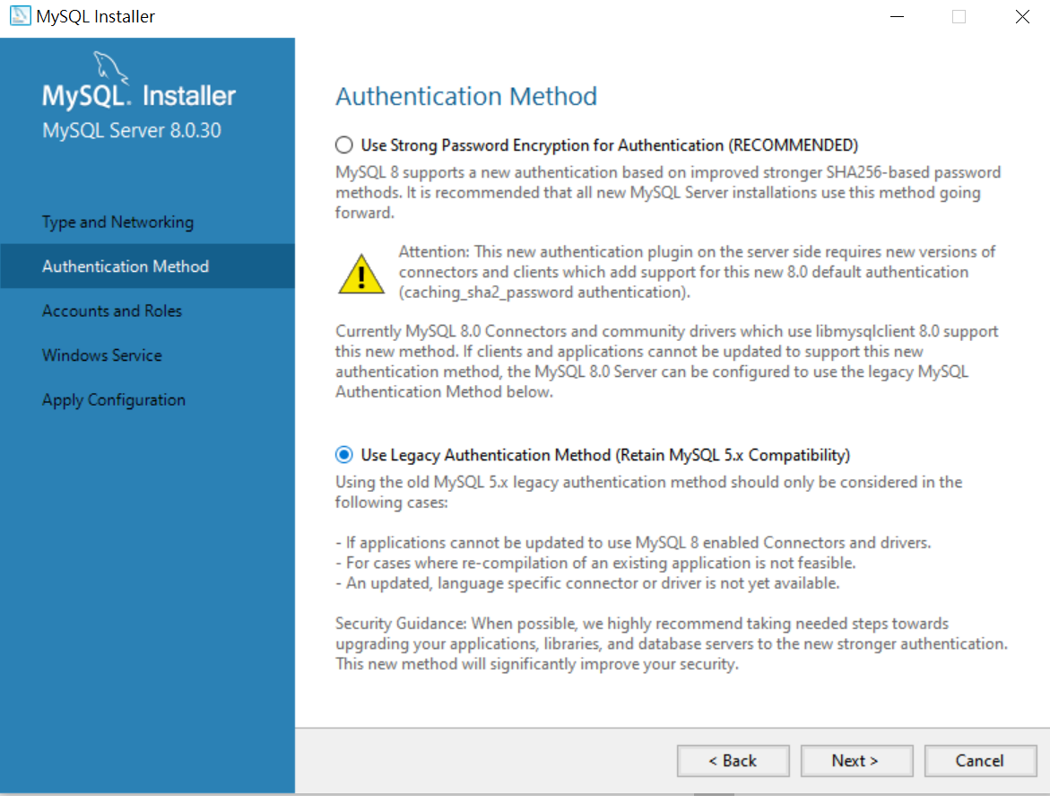
先試試看傳統的認證方式

Slide 16
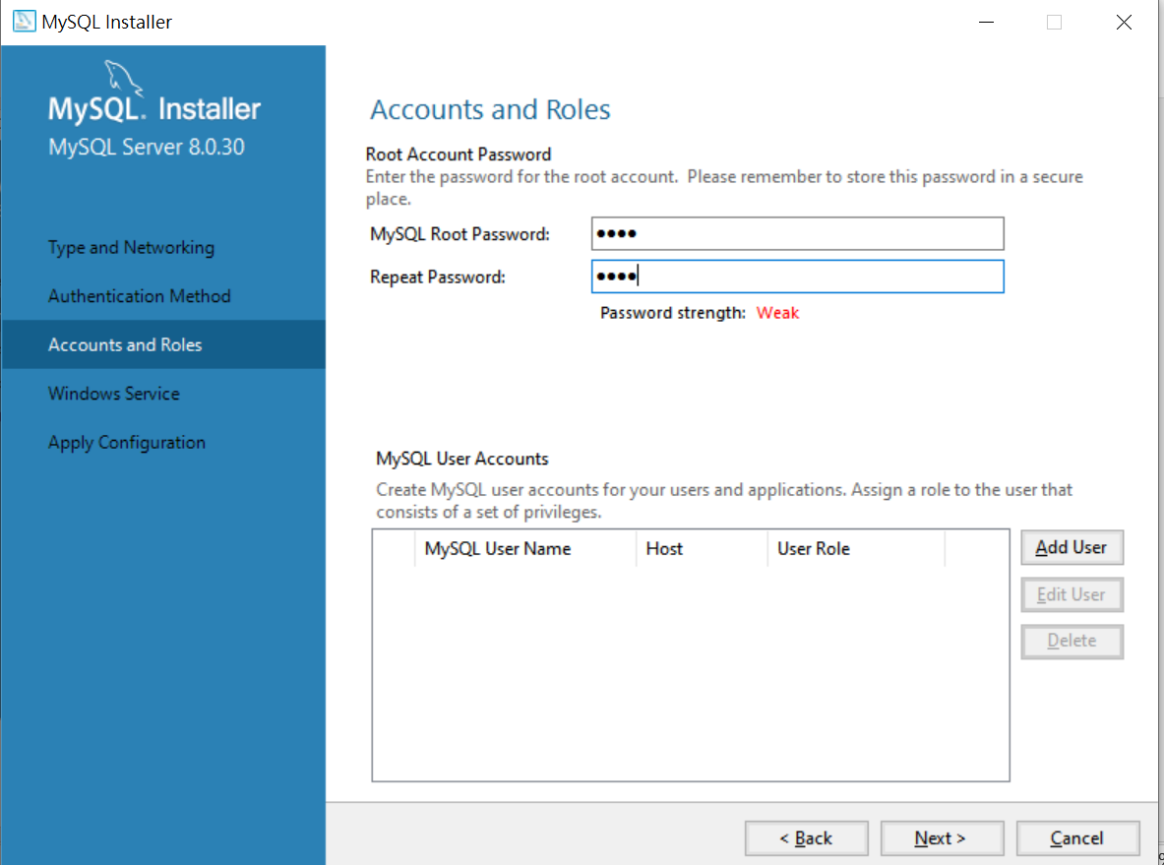
記住root (管理者)之帳號密碼 (先設為root)

Slide 17
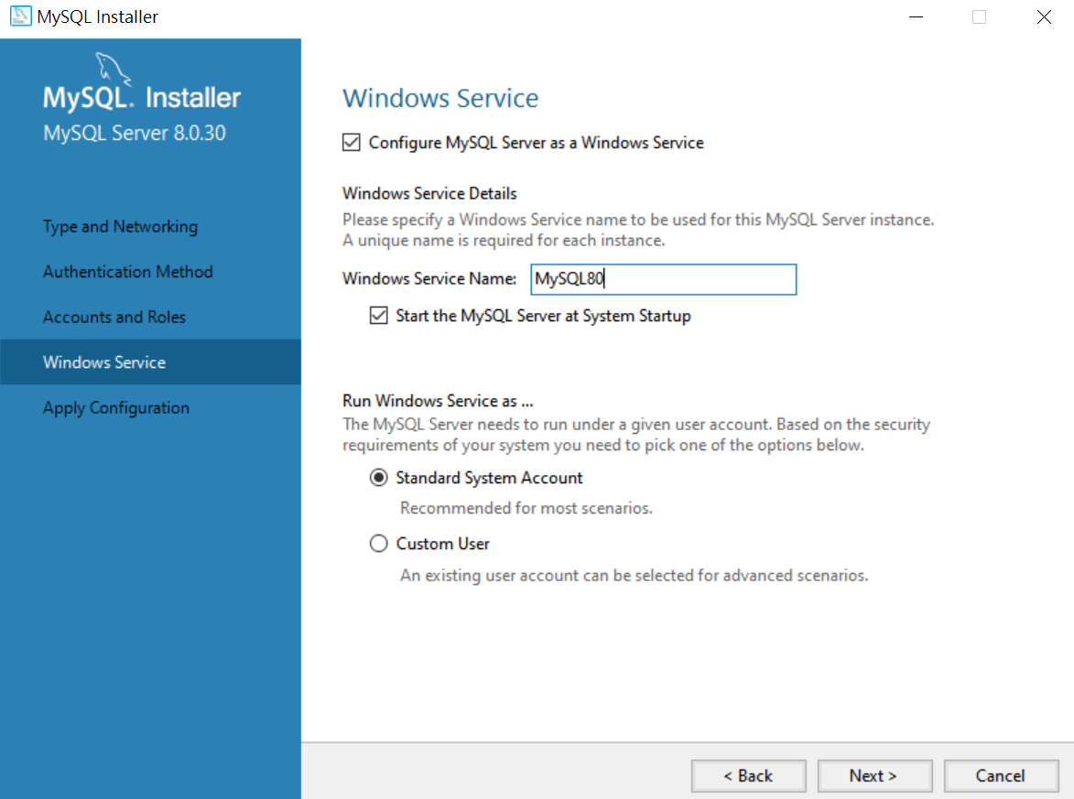

Slide 18
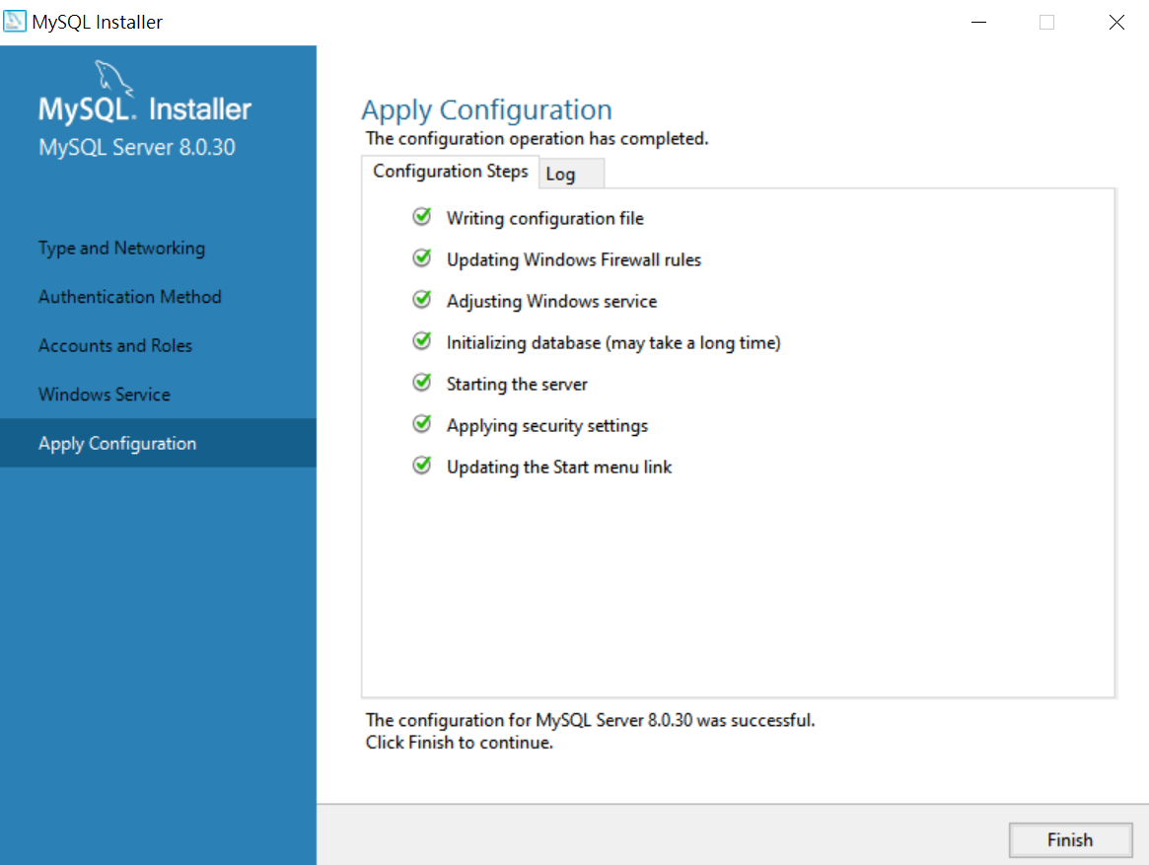

Slide 19
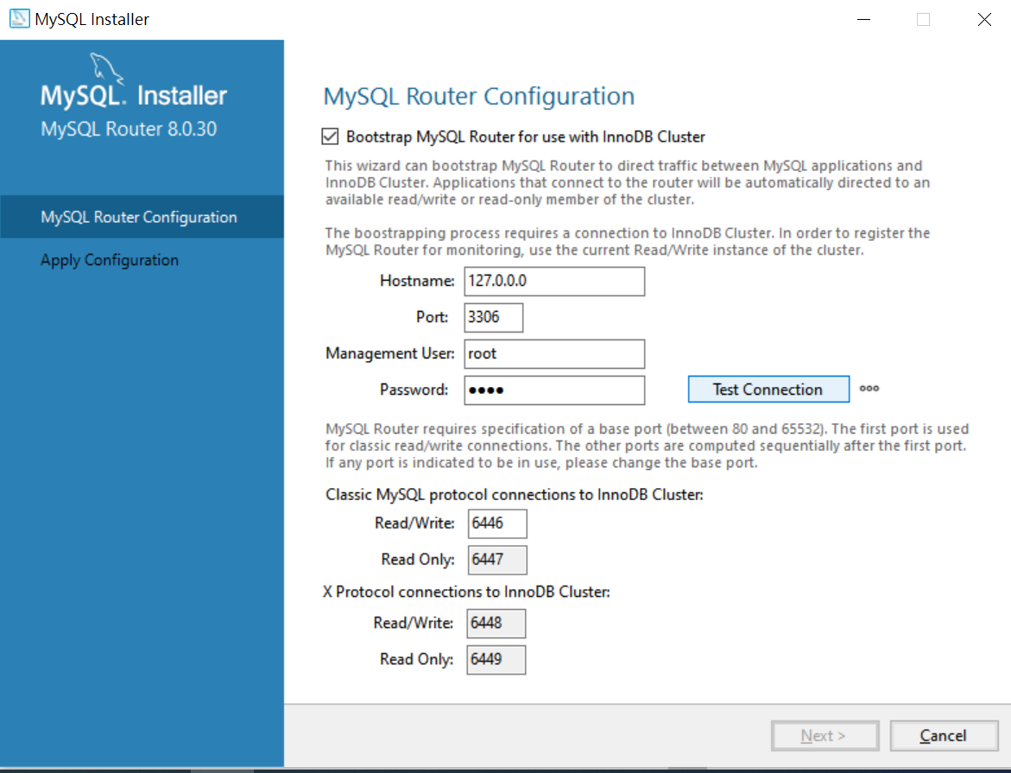
設定連線設定，先記好，以備後用，Skip亦可

Slide 20
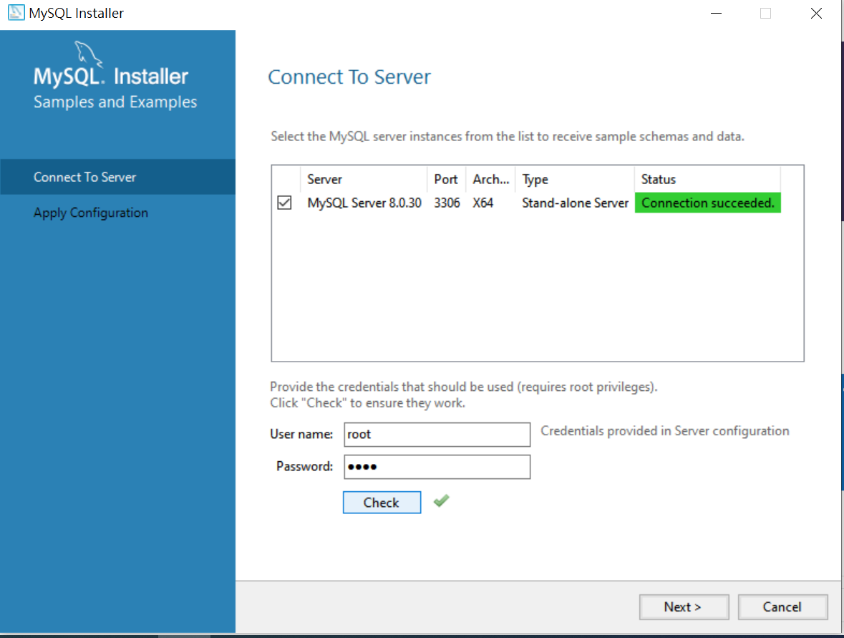
測試連線與帳密

Slide 21
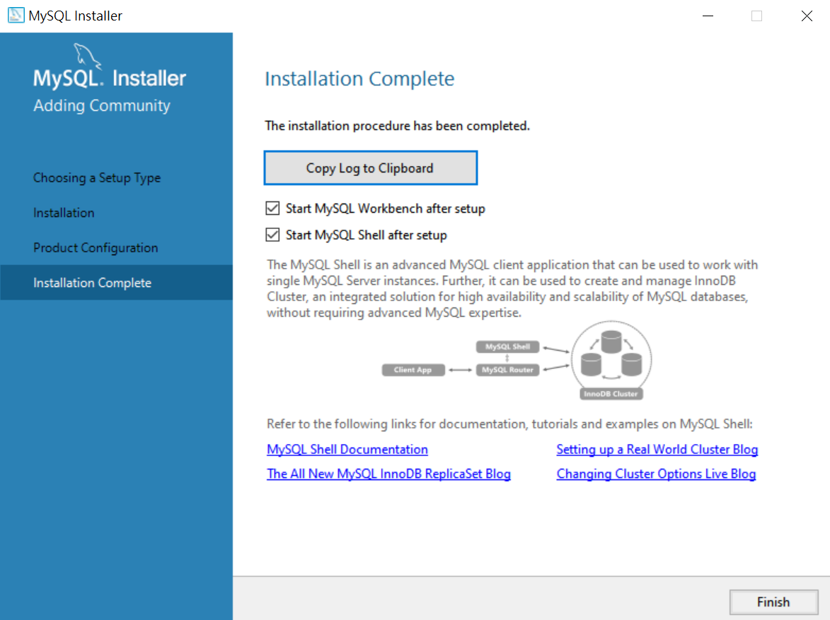

Slide 22
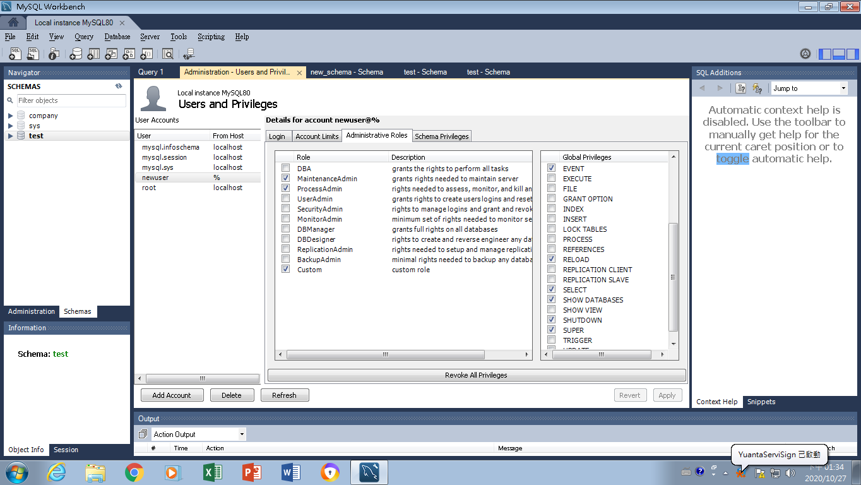
打開MySQL Workbench來創建新的資料庫(Schema) test

Slide 23
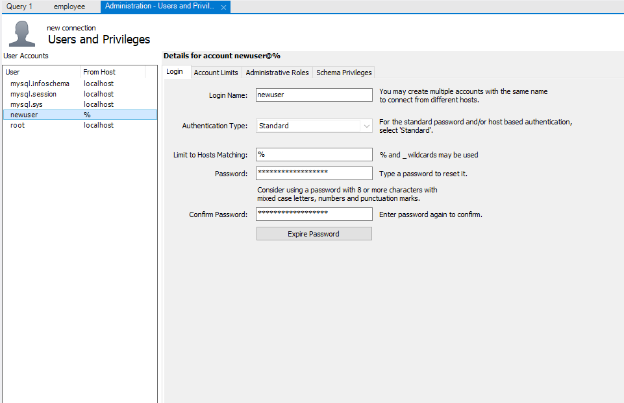
從任何機器連進來皆可

Slide 24
Grant database access to users

Slide 25
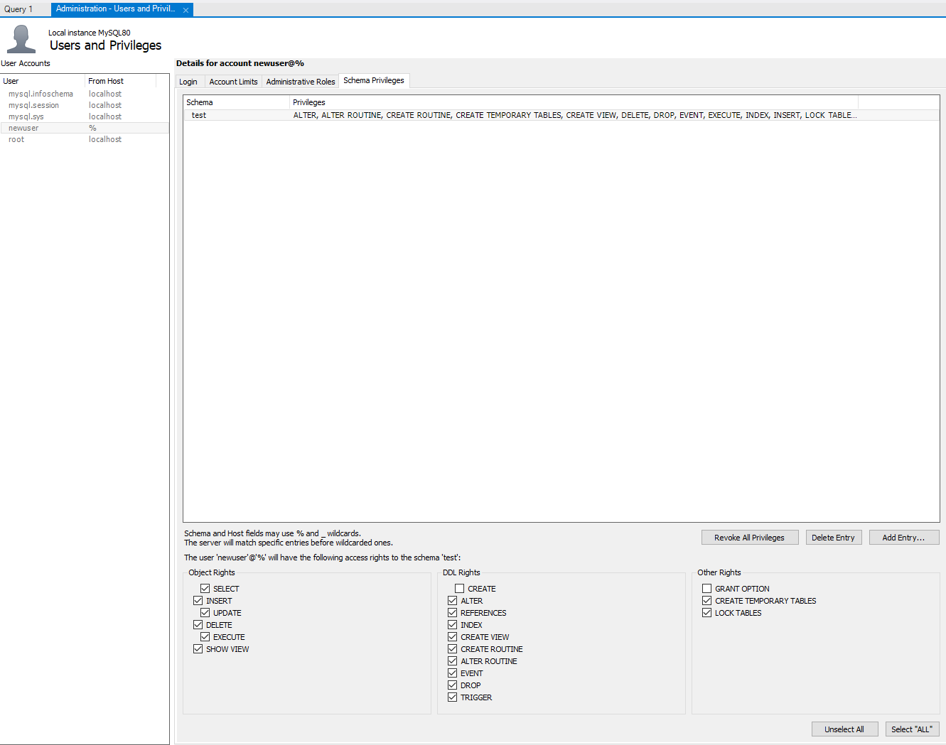
設定某一資料庫的權限給新使用者

Slide 26
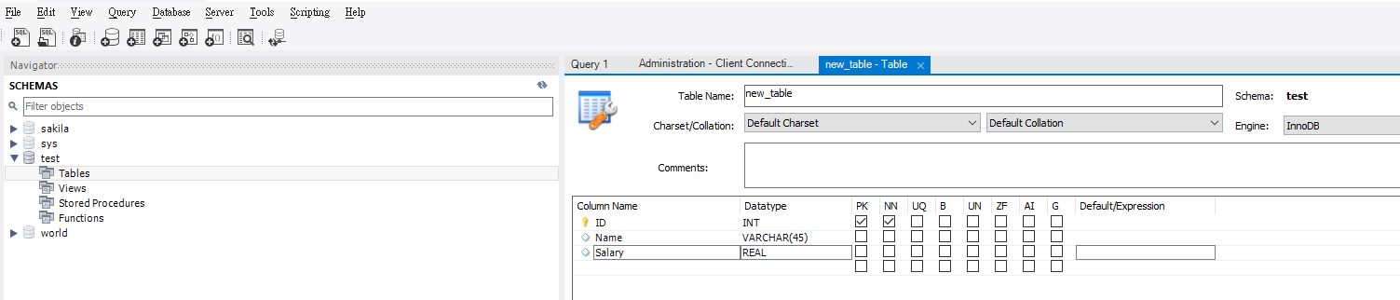
創建新的表格

Slide 27
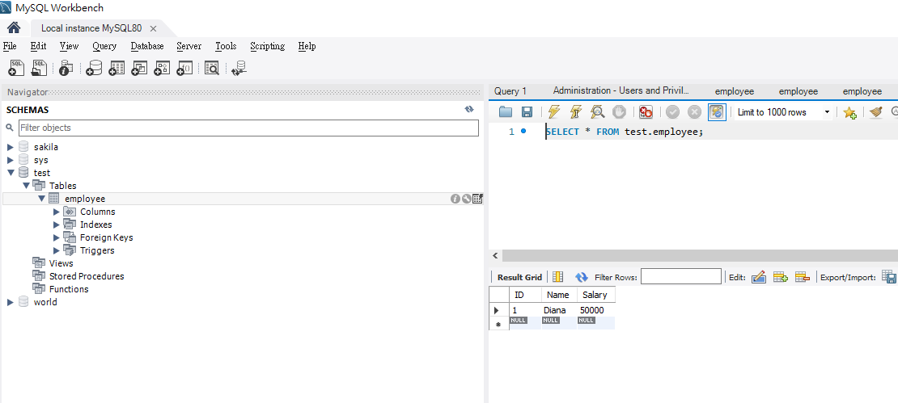
瀏覽表格資料

Slide 28
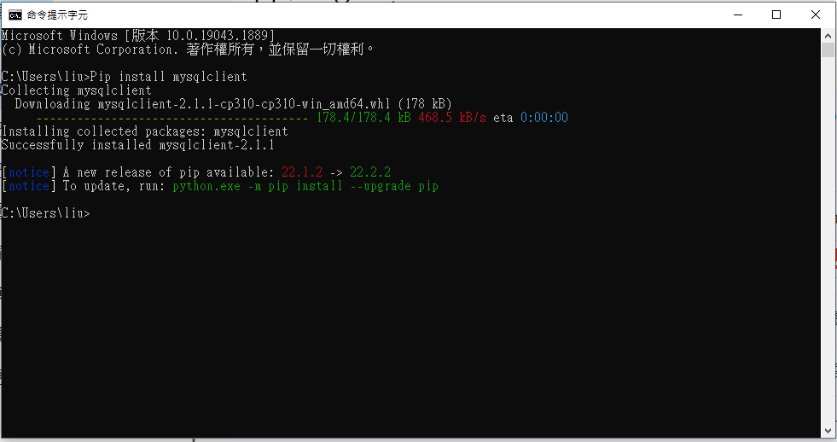
Install mysqlclient
Install mysqlclient with “pip install mysqlclient”

Slide 29
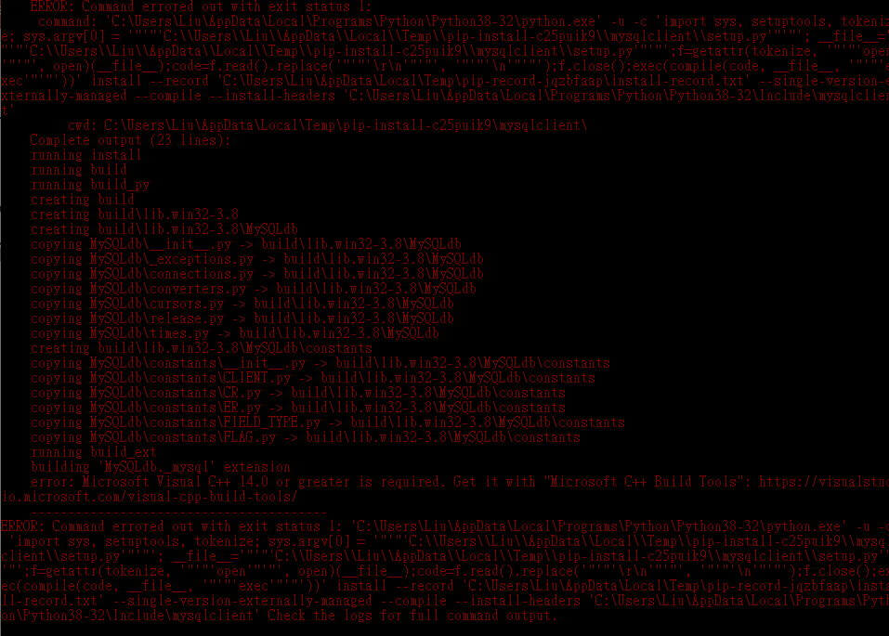
Microsoft Visual C++ 14.0 or greater is required
Python 3.8-win32
Pip install mysqlclient ➔ 可能 ERROR!!!
Failed building wheel for mysqlclient
error: Microsoft Visual C++ 14.0 or greater is required. Get it with "Microsoft C++ Build Tools": https://visualstudio.microsoft.com/visual-cpp-build-tools/
Solving way(based on https://stackoverflow.com/questions/63113305/how-to-install-mysqlclient-for-django-in-windows-10):
(a) install Microsoft Visual C++ 14.0 tools (about 2G? → too heavy)
(b) download pre-compiled binaries ➔https://www.lfd.uci.edu/~gohlke/pythonlibs/#mysqlclient

Slide 30
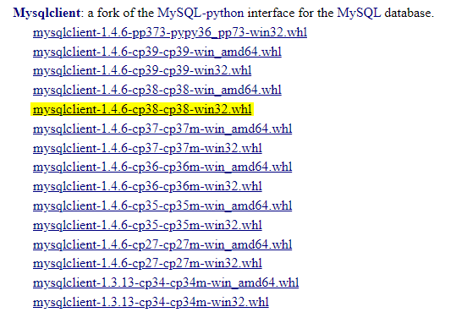
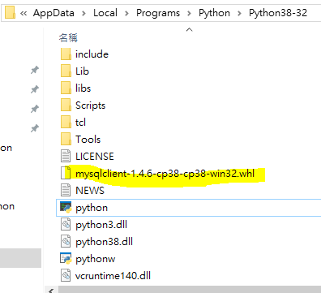
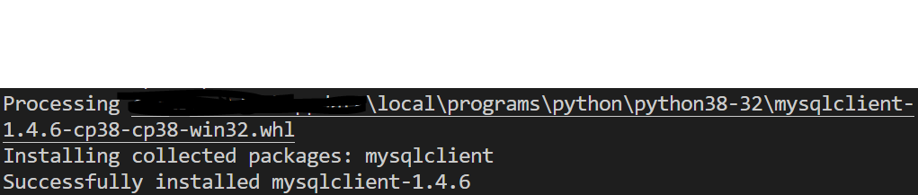
Download pre-compiled binaries
Download to the python directory
Install in VS code
pip install mysqlclient-1.4.6-cp38-cp38-win32.whl

Slide 31
撰寫程式 (查詢)
import MySQLdb
db=MySQLdb.connect(host="localhost", user="newuser", password=“xxxx", db="test")
print ("connected")
cur=db.cursor();
cur.execute("Select * from employee")
# 該資料庫 (schema)的權限必須開放select (custom)給該user
cur.execute("Select * from employee" )
for emp in cur.fetchall():
print(emp)

Slide 32
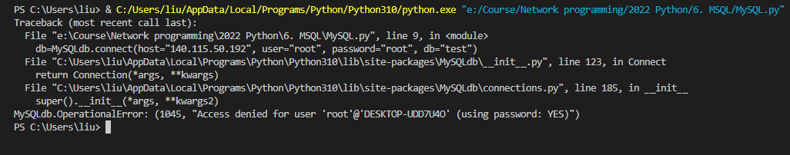
撰寫程式 (查詢)
import MySQLdb
db=MySQLdb.connect(host=“140.115.xx.xx", user=“root", password=“xxxx", db="test")
print ("connected")
cur=db.cursor();
cur.execute("Select * from employee")
# 該資料庫 (schema)的權限必須開放select (custom)給該user
cur.execute("Select * from employee" )
for emp in cur.fetchall():
print(emp)
Root僅能從localhost連線

Slide 33
撰寫程式 (Insert)
import MySQLdb
db=MySQLdb.connect(host="localhost", user="newuser", password="Newuser@999", db="test")
cur=db.cursor();
cur.execute("Insert into employee Values(2, 'John', 8000)")
cur.execute("Insert into employee Values(3, 'Peter', 7000)")
# 該資料庫 (schema)的權限必須開放select (custom)給該user
cur.execute("Select * from employee" )
for emp in cur.fetchall():
print(emp)

Slide 34
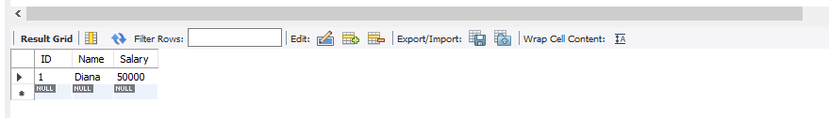
撰寫程式 (Insert)
進Workbench查詢，資料並沒更新，Why? ➔ 交易沒有commit。需要Commit之後資料庫才真正更新，DBMS需要以此指令作交易管理。

Slide 35
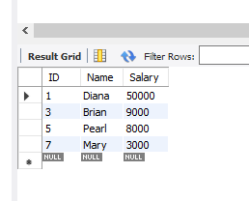
撰寫程式 (Insert)
import MySQLdb
db=MySQLdb.connect(host="localhost", user="root", password="root", db="test")
cur=db.cursor()
cur.execute("Select * from employee" )
for emp in cur.fetchall():
print(emp)
print ("-----------------------------------------------------")
cur.execute("insert into Employee values(3, 'Brian', 9000)" )
# 該資料庫 (schema)的權限必須開放select (custom)給該user
cur.execute("Select * from employee" )
for emp in cur.fetchall():
print(emp) db.commit()
db.close()

Slide 36
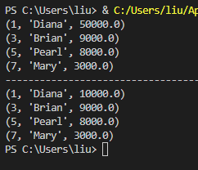
撰寫程式 (update)
import MySQLdb
db=MySQLdb.connect(host="localhost", user="newuser", password="Newuser@999", db="test")
cur=db.cursor()
cur.execute("Select * from employee" )
for emp in cur.fetchall():
print(emp)
print ("-----------------------------------------------------")
cur.execute("update employee set salary= 10000 where ID=1" )
# 該資料庫 (schema)的權限必須開放select (custom)給該user
cur.execute("Select * from employee" )
for emp in cur.fetchall():
print(emp)
db.commit()
db.close()

Slide 37
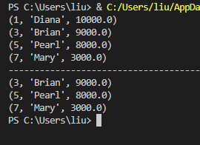
撰寫程式 (delete)
import MySQLdb
db=MySQLdb.connect(host="localhost", user="newuser", password="Newuser@999", db="test")
cur=db.cursor()
cur.execute("Select * from employee" )
for emp in cur.fetchall():
print(emp)
print ("-----------------------------------------------------")
cur.execute("delete from employee where ID=1" )
# 該資料庫 (schema)的權限必須開放select (custom)給該user
cur.execute("Select * from employee" )
for emp in cur.fetchall():
print(emp)
db.commit()
db.close()

Slide 38
Trigger
Trigger 可監控表格變化，當被觸發時可自動執行所指定之指令
監控之時機
Before insert
After insert
Before update
After update
Before delete
After Delete
參考 http://mysqltutorial.org/mysql-triggers/mysql-after-insert-trigger/

Slide 39
Trigger
an AFTER INSERT trigger that inserts a reminder into the reminders table if the birth date of the member is NULL.
CREATE TRIGGER after_members_insert
AFTER INSERT
ON members FOR EACH ROW
BEGIN
IF NEW.birthDate IS NULL THEN
INSERT INTO reminders(memberId, message) VALUES(new.id, CONCAT('Hi ', NEW.name, ', please update your date of birth.'));
END IF;
END

Slide 40


Trigger
INSERT INTO members(name, email, birthDate)
VALUES
('John Doe', 'john.doe@example.com', NULL),
('Jane Doe', 'jane.doe@example.com','2000-01-01');

Slide 41
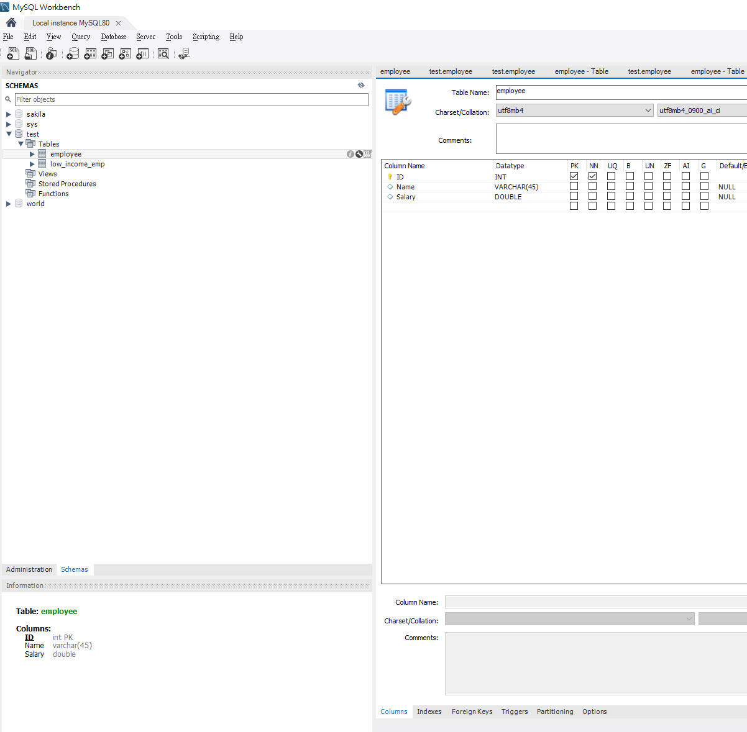
Specify Trigger with MySQL Workbench
如果加入一筆員工資料，薪水低於最低薪資(18000)，將此員工的ID與薪水放入Low_Income_EMP (ID, Salary)表格中
Select the table on which you want to create a trigger (Here Employee)
Click the toolbar of the table
點擊來設定Trigger

Slide 42
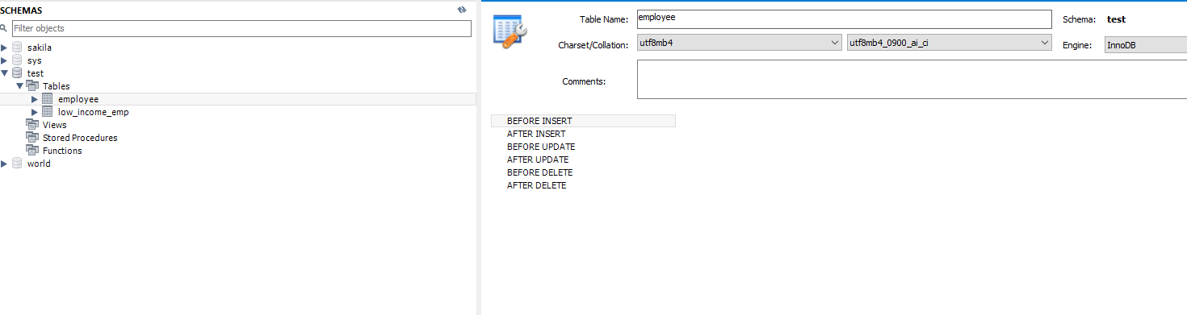
Specify Trigger with MySQL Workbench
選擇After Insert 來設定Trigger

Slide 43
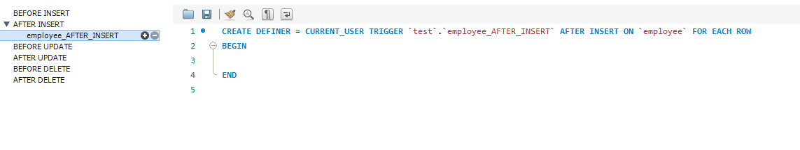
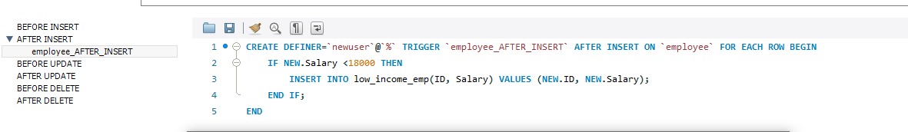
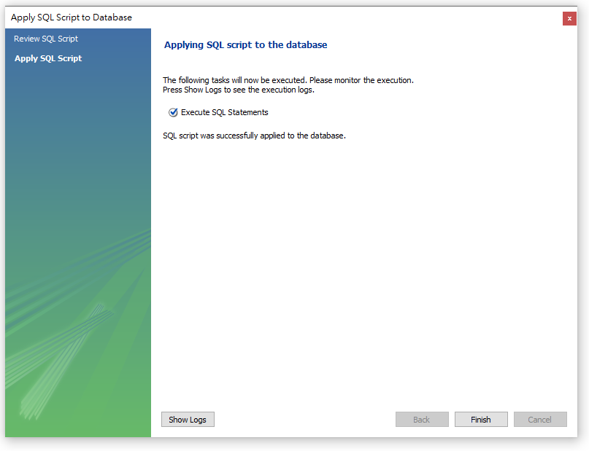
Specify Trigger with MySQL Workbench
CREATE DEFINER = CURRENT_USER TRIGGER `test`.`employee_AFTER_INSERT` AFTER INSERT ON `employee` FOR EACH ROWBEGIN IF (new.salary<18000) THEN INSERT INTO LOW_INCOME_EMP VALUES(new.id, new.salary); ENDIFEND
點擊+ 來設定Trigger

Slide 44
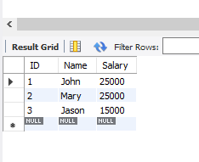
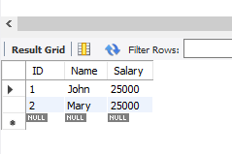
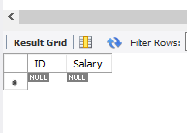
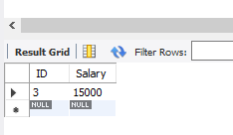
Specify Trigger with MySQL Workbench
Employee
Employee
After insert Jason record
Low_income_emp
Low_income_emp

